Slide 1
Red Blood Indices

Slide 2
RBC indices include:
Mean Corpuscular Volume (MCV).
Mean Corpuscular Hemoglobin (MCH).
Mean Corpuscular Hemoglobin Concentration (MCHC) .

Slide 3
Mean Corpuscular volume:
MCV is average size of RBC
MCV = Hct x 10 fimtolitre
RBC (millions)
If 80-100 fL , normal range, RBCs considered normocytic.

Slide 4
Mean Corpuscular Hemoglobin (MCH)
MCH is average weight of hemoglobin per RBC.
MCH = Hgb x 10 Picogram
RBC (millions)
Normal range 27– 32 pg

Slide 5
Mean Corpuscular Hemoglobin Concentration (MCHC) :
MCHC is average hemoglobin concentration per RBC .
MCHC = Hgb x 100
Hct (%)
Normal range 31—37% (g/dl)
If MCHC is normal, cell described as normochromic .
If MCHC is less than normal, cell described as hypochromic .
There are no hyperchromic RBCs.

Slide 6
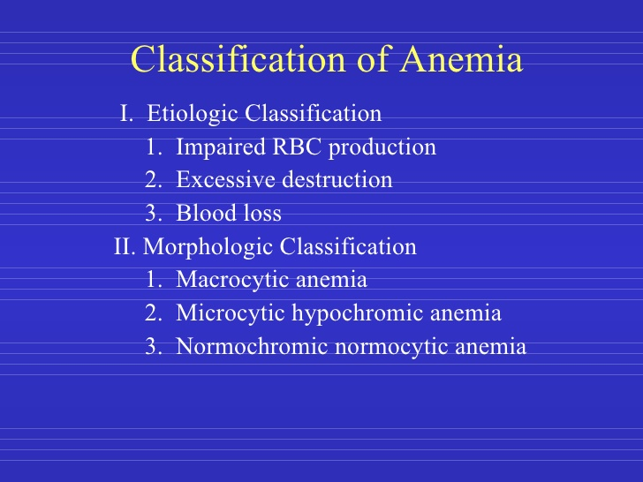

Slide 7
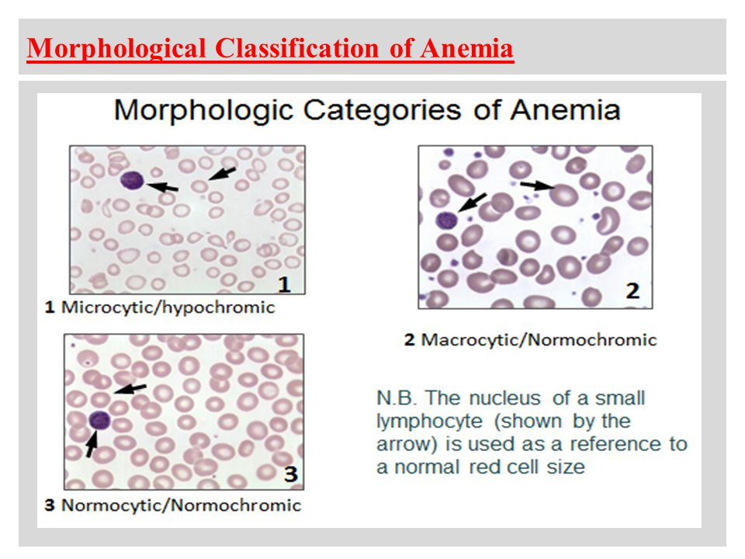

Slide 8
